Slide 1
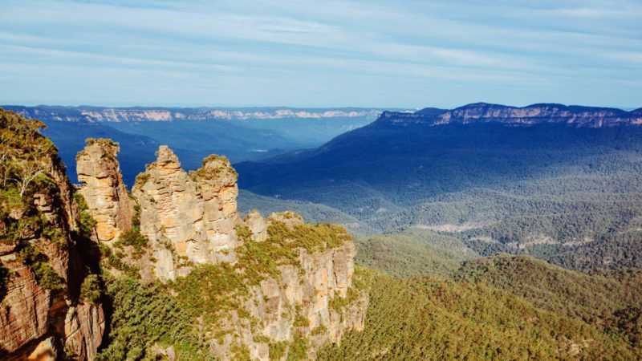

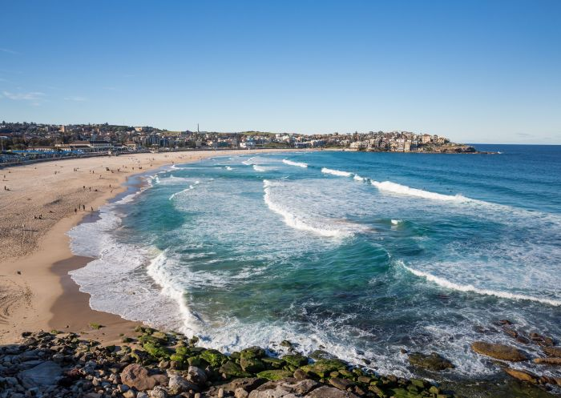
Blue Mountains
N A T U R E O F S Y D N E Y
Bondi Beach

